Slide 1
Karen Yeowell, volunteer
New England Orienteering Club
Our Request: permission to hang orienteering markers (called controls) in the Morgan Property as part of an orienteering event in Prouty Woods December 1-10, 2023

Slide 2
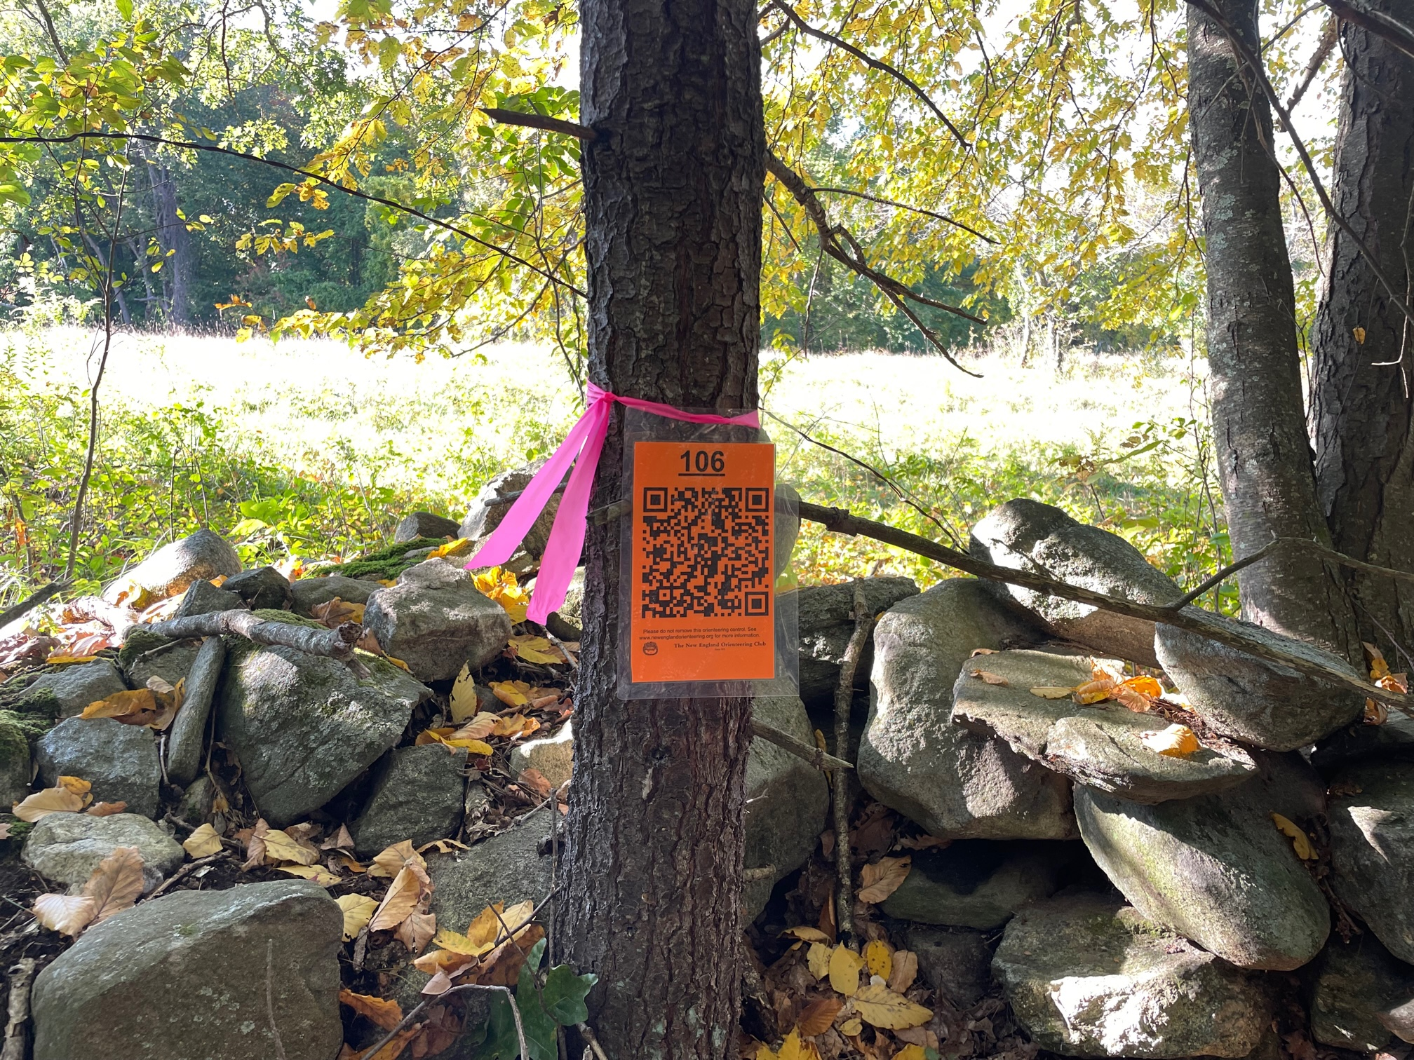
What is Orienteering?
Sport in which you use a map (with control locations circled) and compass to locate and scan controls in order in the fastest time possible.

Slide 3
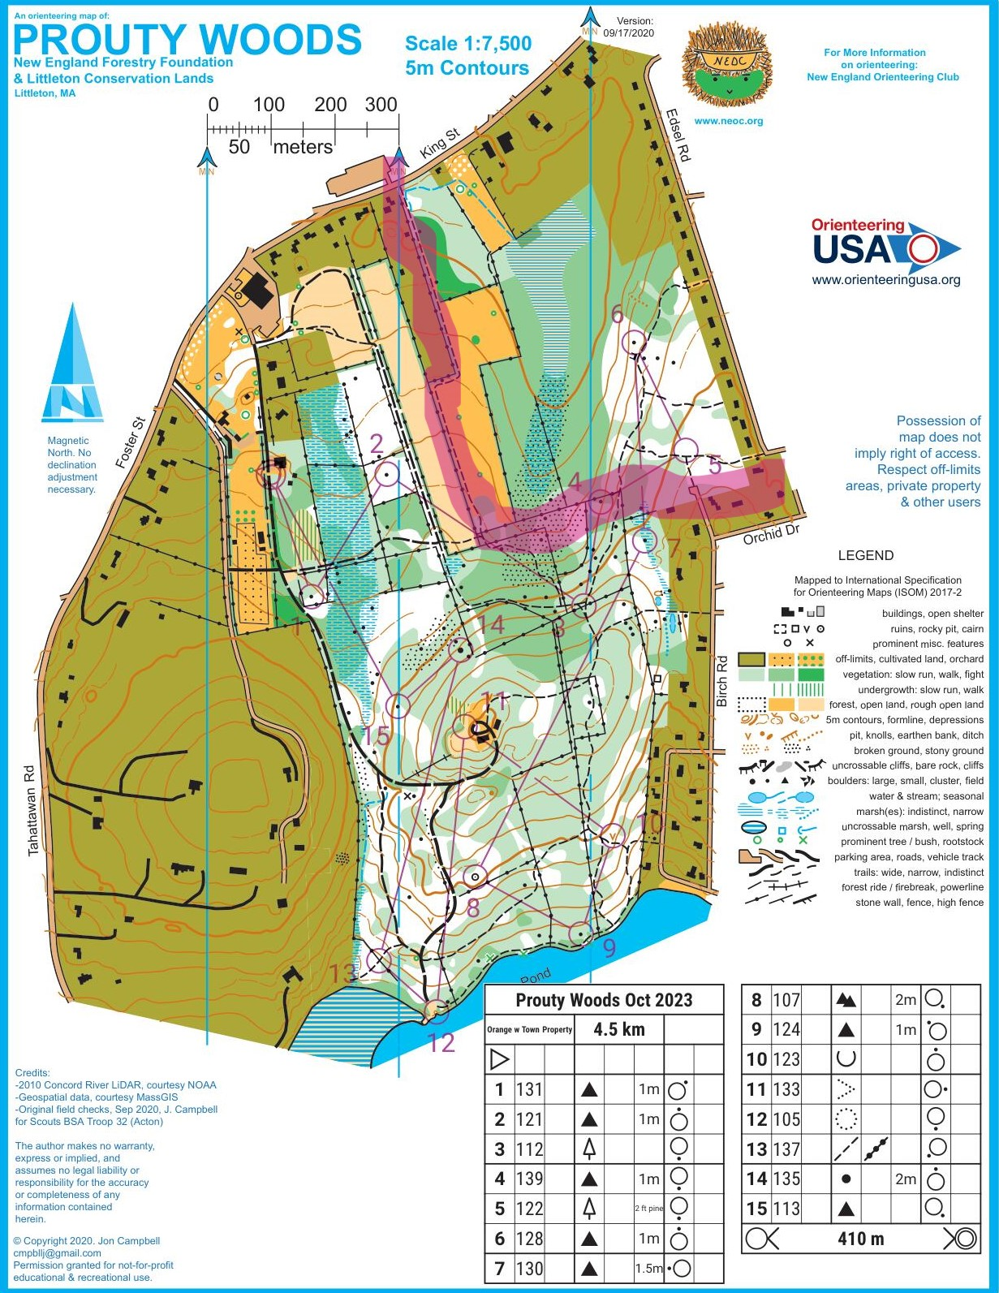
Parking: NEFF lot
Start/Finish: NEFF barn
Morgan Property Use: 2-4 controls, locations to be finalized but likely as indicated on map by numbers 4, 5, & 6.
Participants: NEOC members & general public – expect ~50 over 10 days
Morgan Property
Parking
Start

