Slide 1
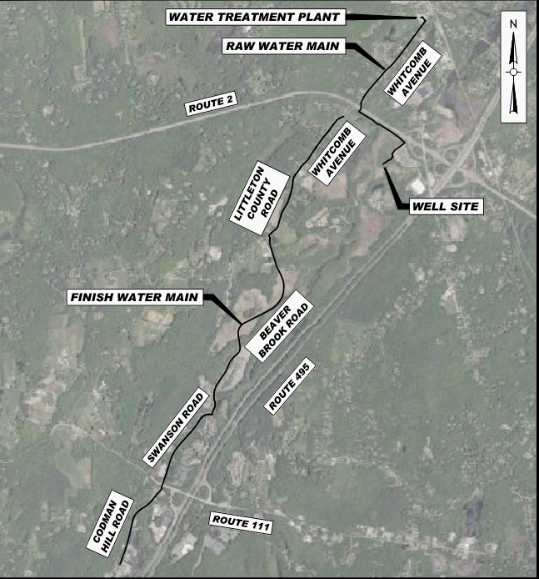

BOXBOROUGH-LITTLETON WATER LINE EXTENSION PROJECT

Slide 2
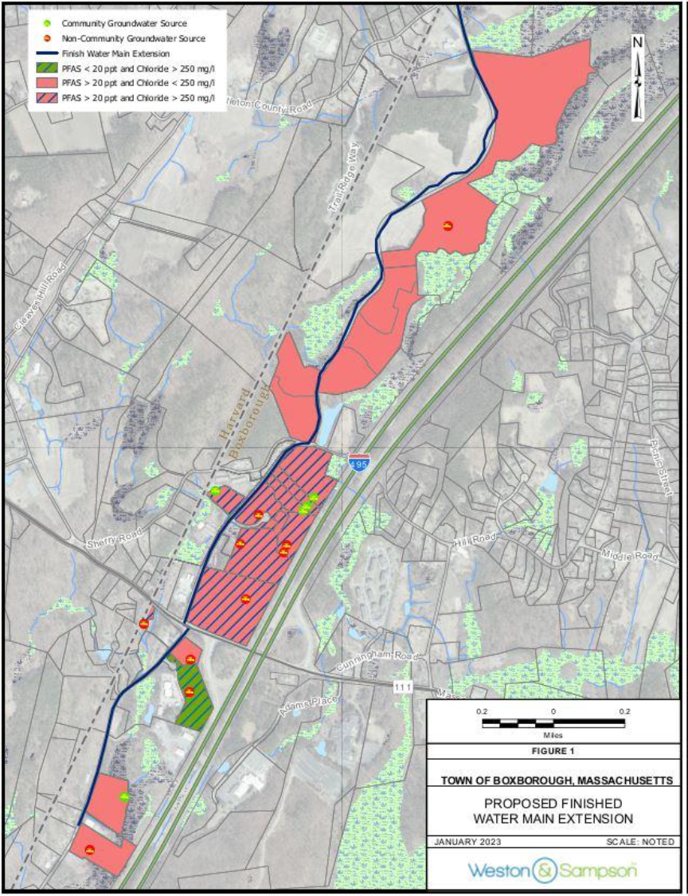
Background
Water line to address PFAS and sodium chloride contamination of 11 public water systems
Work is being done to address contamination from MassDOT salt storage of PWS in Boxborough. MassDOT, MassDEP, LELWD, and the Town of Boxborough are all project partners. An intermunicipal agreement has been approved for the municipalities.
This project also involves construction of a new groundwater well and associated pump station to transfer water from the new well to the new Whitcomb Avenue PFAS Water Treatment Plant (WTP)

Slide 3
Proposed Work
Littleton
Boxborough
New Source Well (0.5 MGD)
Access Roadl
Raw Water Transmission Main
Water from the proposed new well will be pumped to the existing WTP on Whitcomb Ave through a new raw water main
Replacement Water Main
Existing water main along Whitcomb Ave from Taylor Road to ~142 Whitcomb Ave will be replaced
Finish Water Transmission Main
4.5 Miles of Water Main will extend from the Littleton/Boxborough Line into Boxborough to provide treated drinking water to the 11 public water systems (PWS) and abutters along the project route in Boxborough that are currently on private groundwater well with Chloride and PFAS concentrations above the MCL.

Slide 4
Site Description
The project work in Littleton includes the construction of the water supply well (0.5 million gallons per day), access road to the well (1,200-foot ±), raw water main connecting the well to the new WTP, and replacement of the existing water main in Whitcomb Ave.

Slide 5
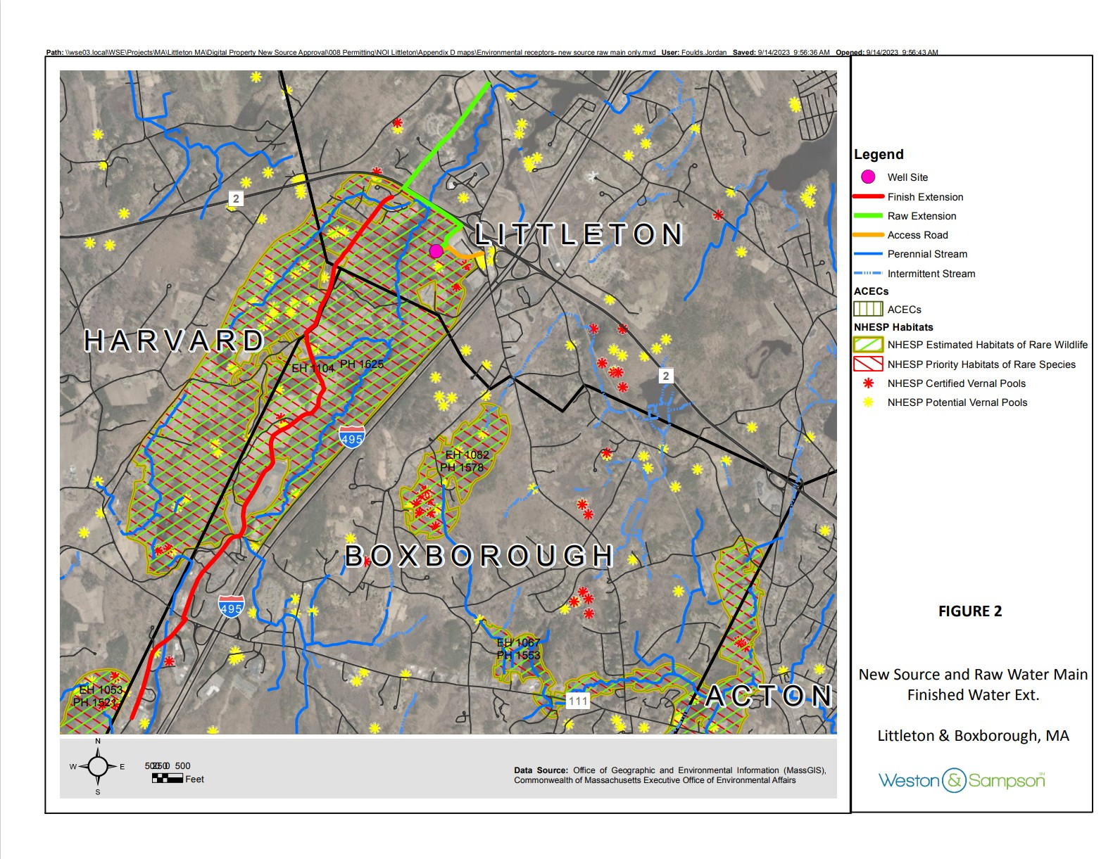

Slide 6
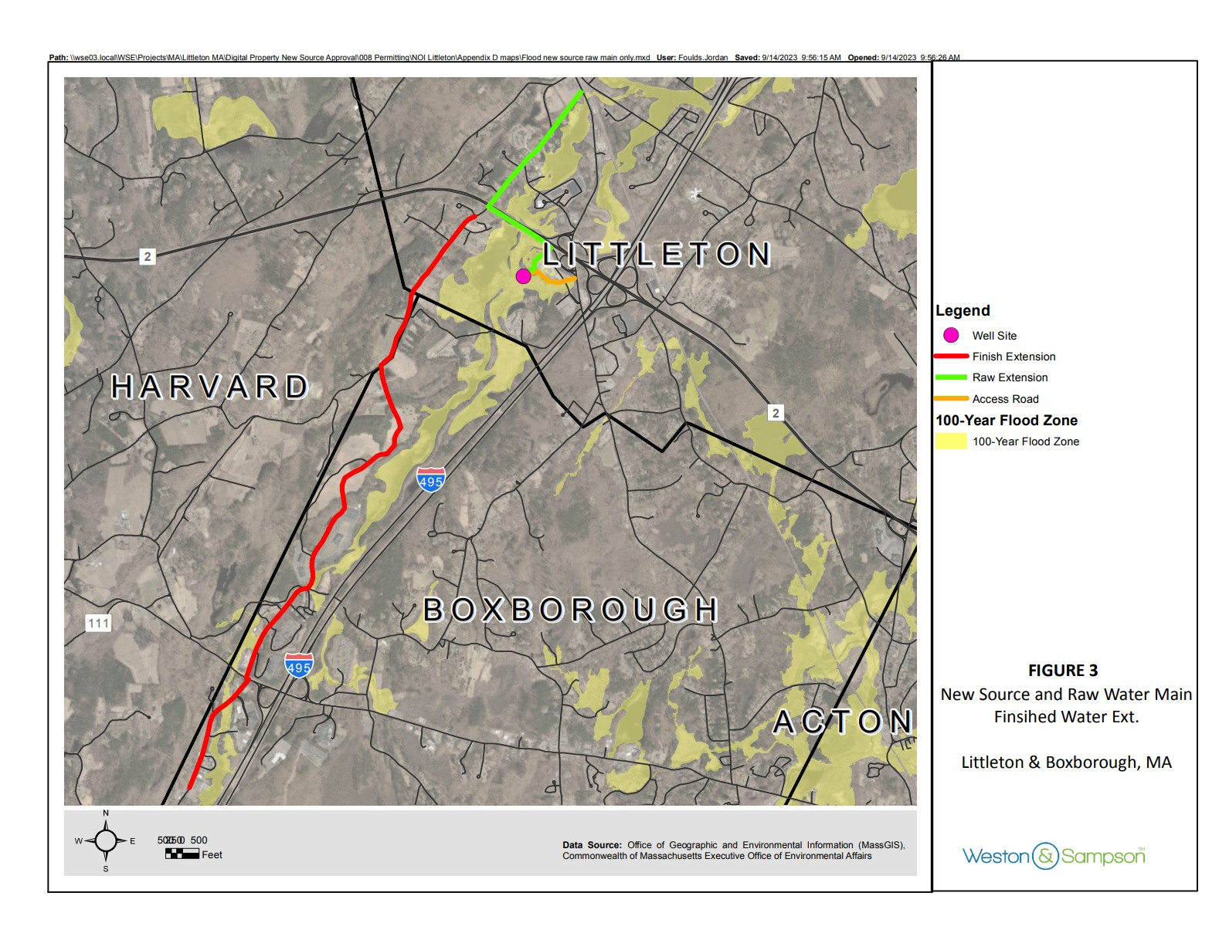

Slide 7
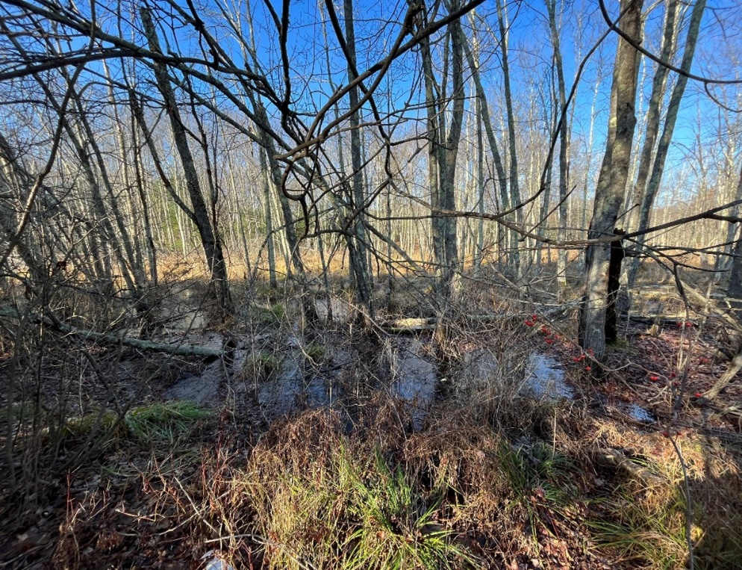
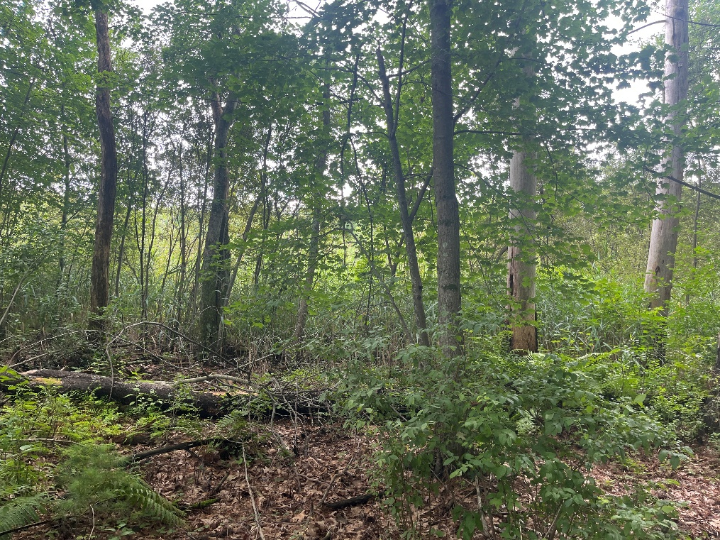
Environmental Resource Areas
Bordering Vegetated Wetland A
Bordering Vegetated Wetland D

Slide 8
Environmental Impacts
Resource Area | Temporary Impact (sf) | Permanent Impact (sf)
Bordering Vegetated Wetlands | 0 | 0
Isolated Vegetated Wetlands | 0 | 0
Bordering Land Subject to Flooding | 7,700 | 2,512
Riverfront Area | 12,643 | 0
Bank | 0 | 0
100’ Wetlands Buffer Zone | 23,177 | 35,754
Erosion controls will be used for the duration of the project including silt fence, catch basin protection, and compost filter tubes.

Slide 9
Environmental Impacts
Resource Area | Cubic Flood Storage Feet Lost | Cubic Feet Replaced
Bordering Land Subject to Flooding | 13.8 | 352

Slide 10




Slide 11
thank you
westonandsampson.com

